Slide 1


Git & GitHub
Versions Control

Slide 2

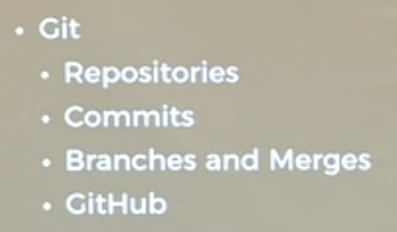

Slide 3
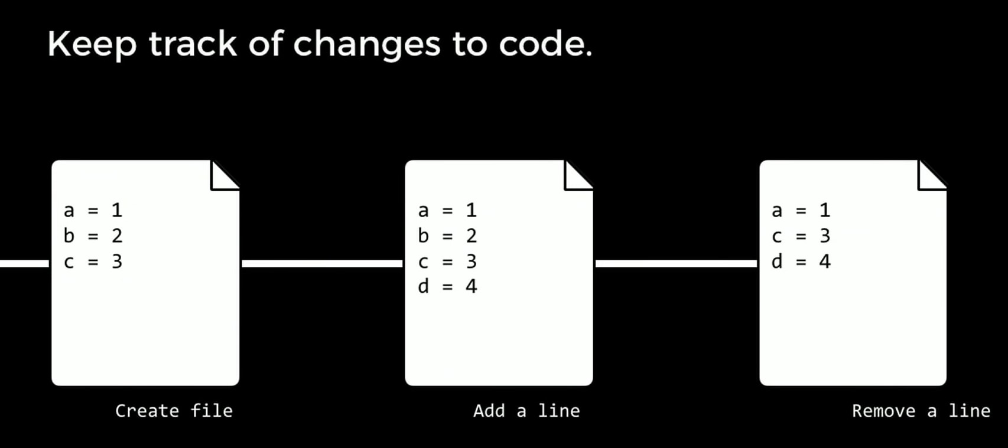

Slide 4
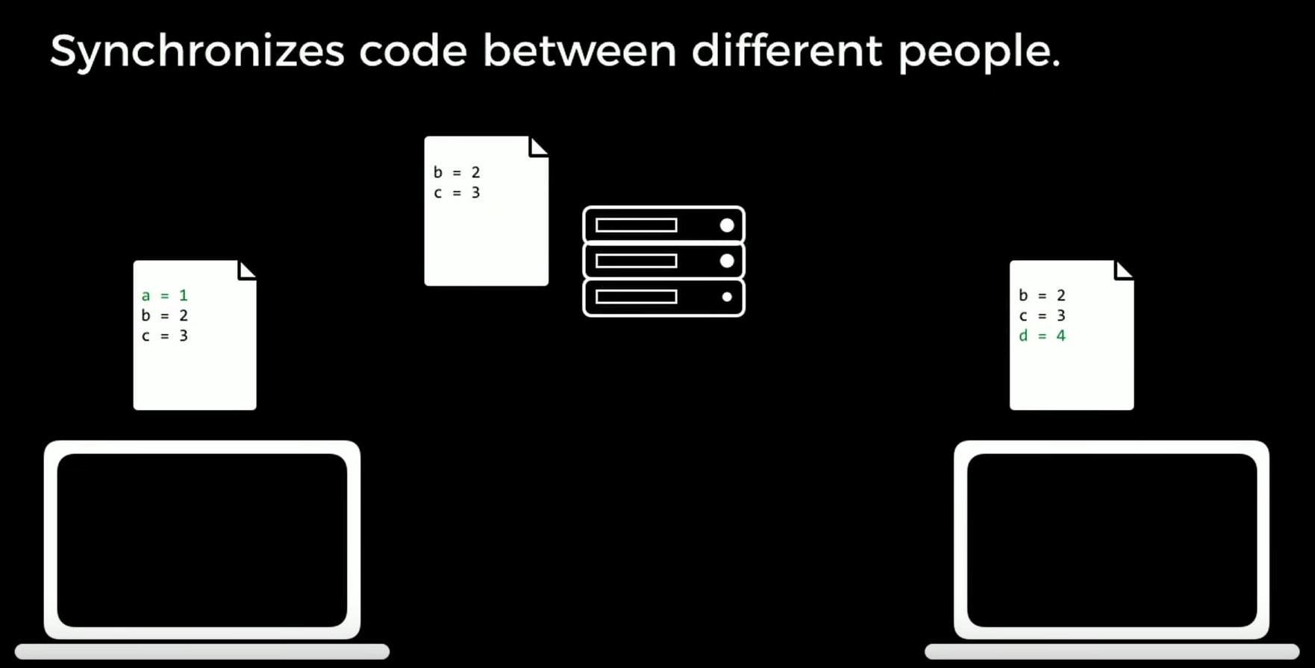

Slide 5
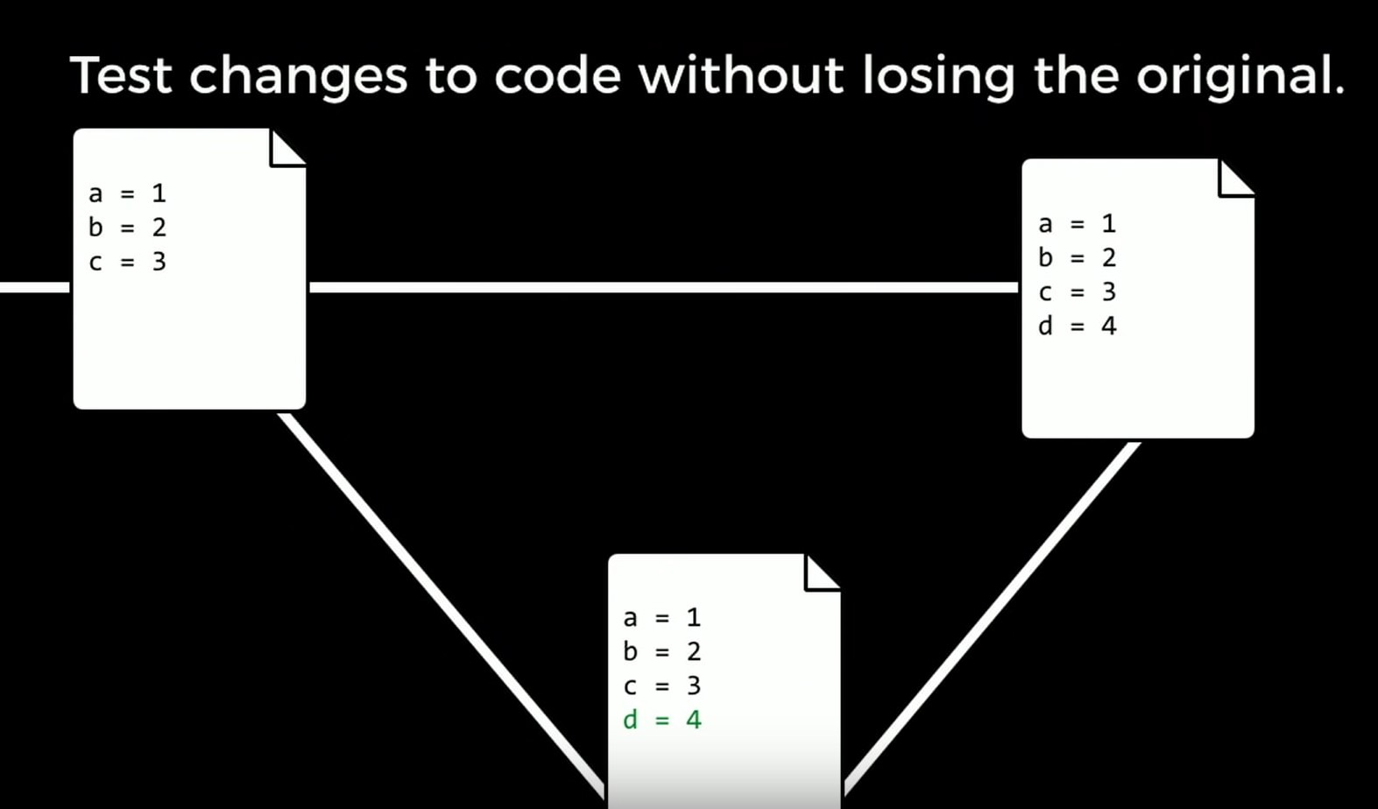

Slide 6
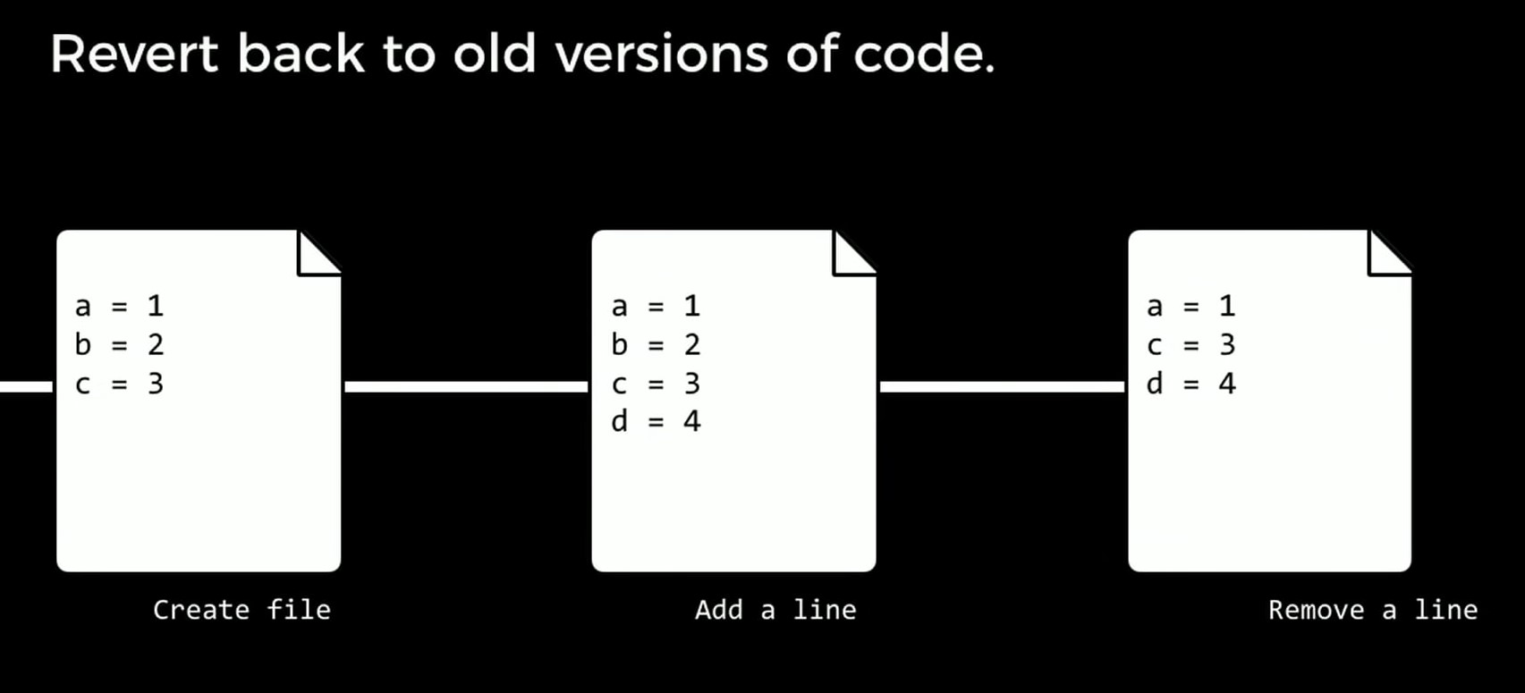

Slide 7


Slide 8


Slide 9
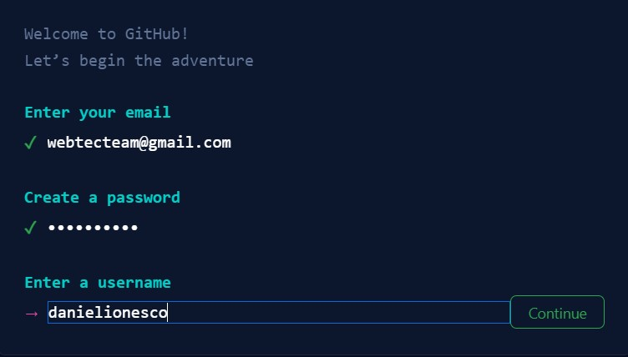

Slide 10
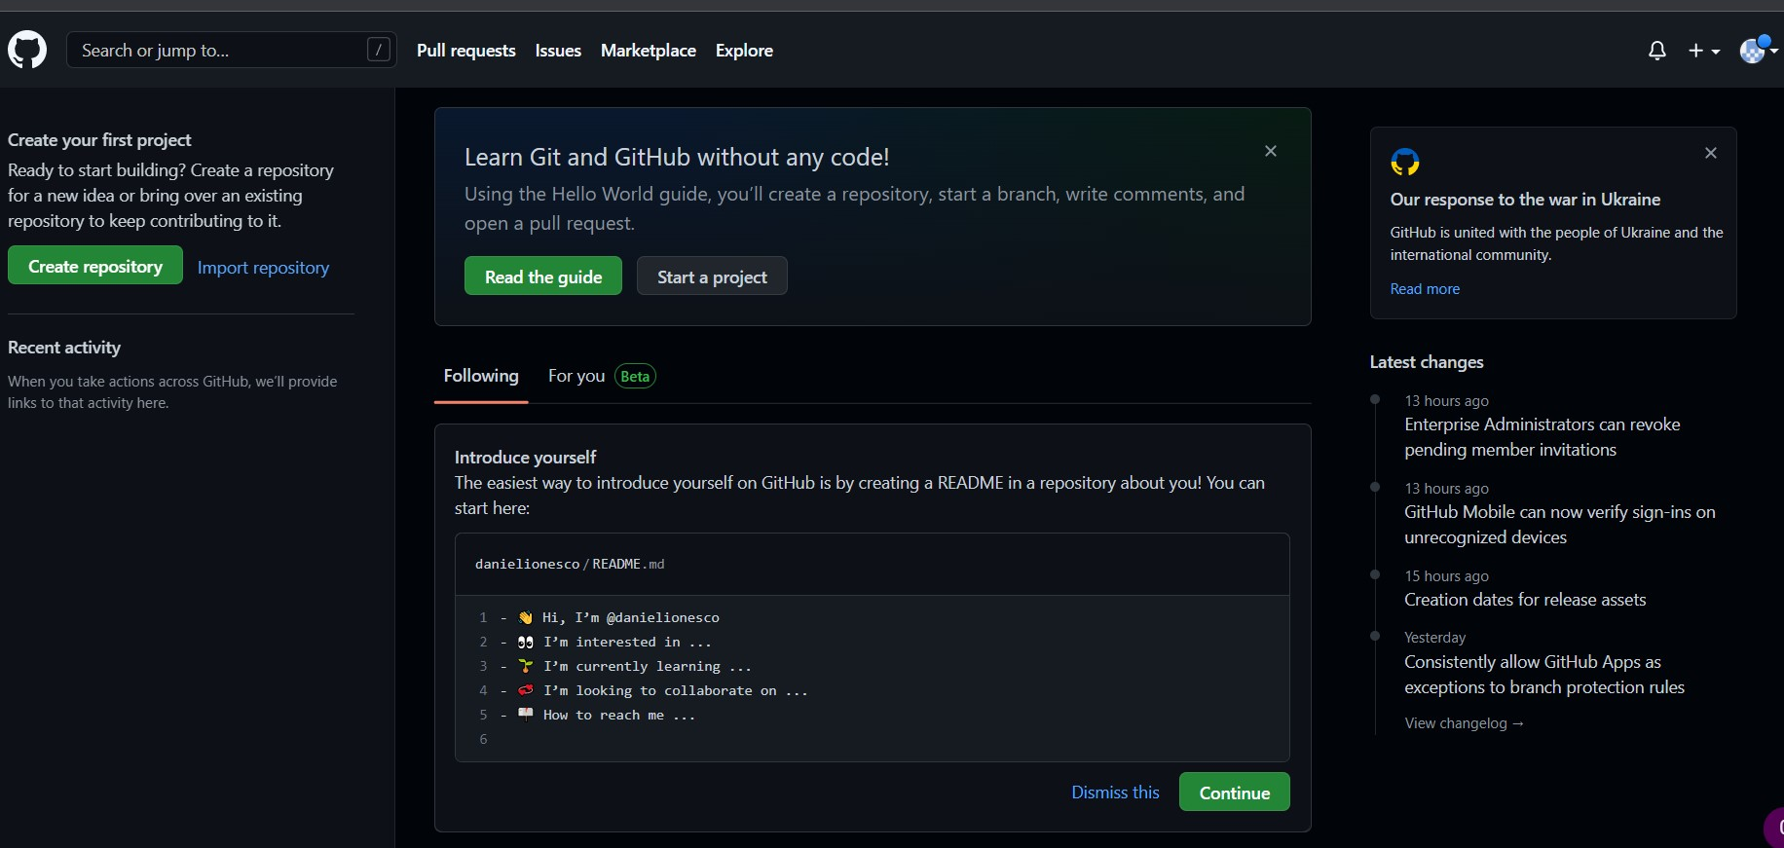

Slide 11
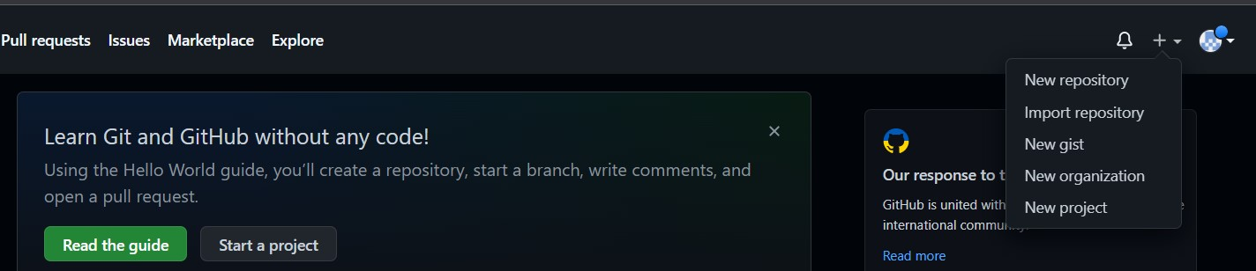
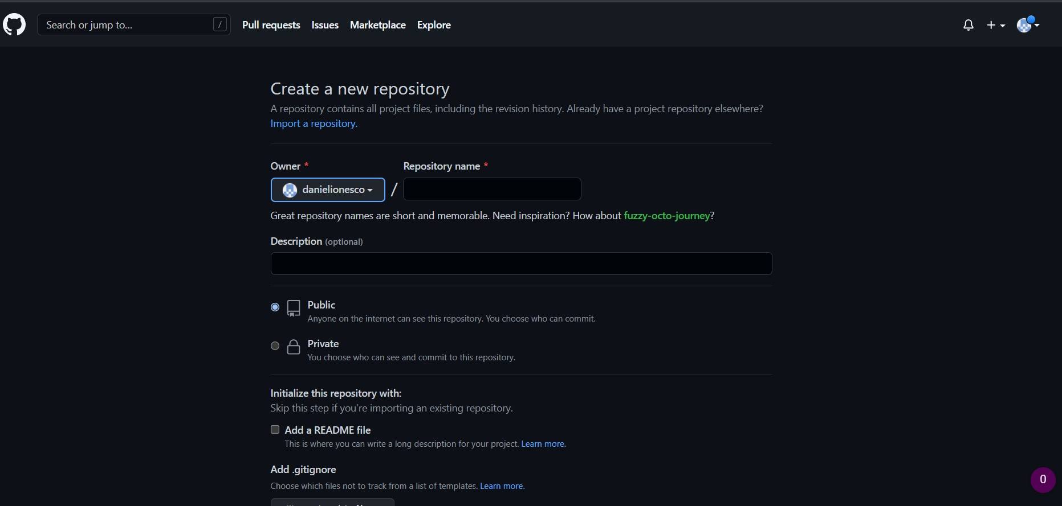

Slide 12
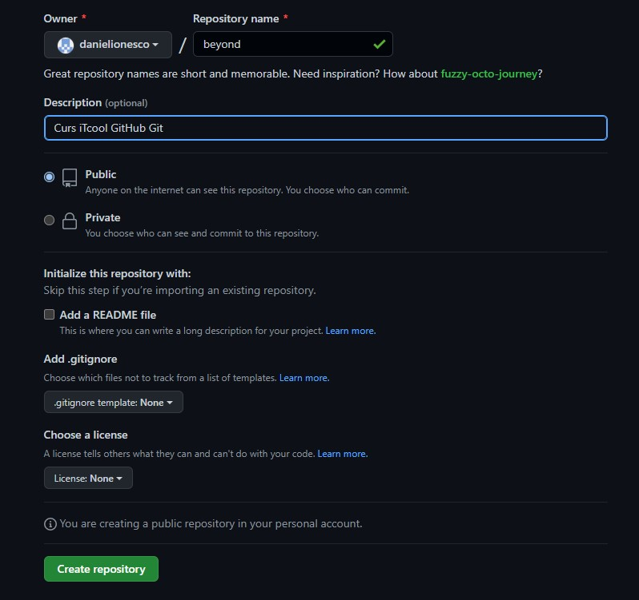

Slide 13
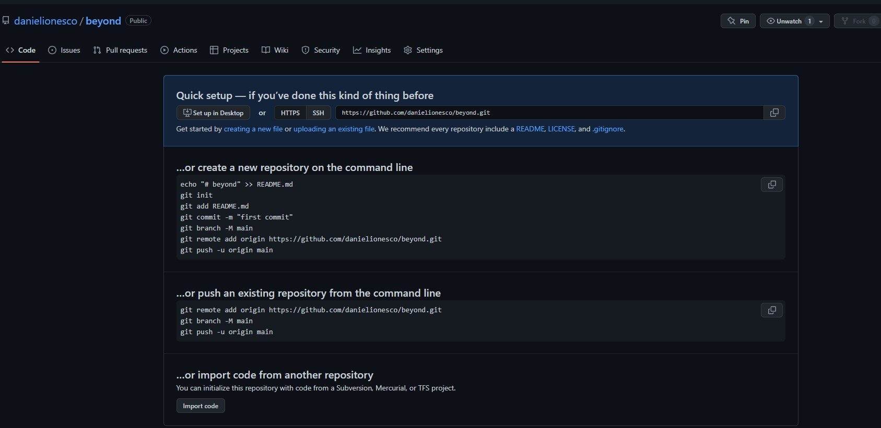

Slide 14
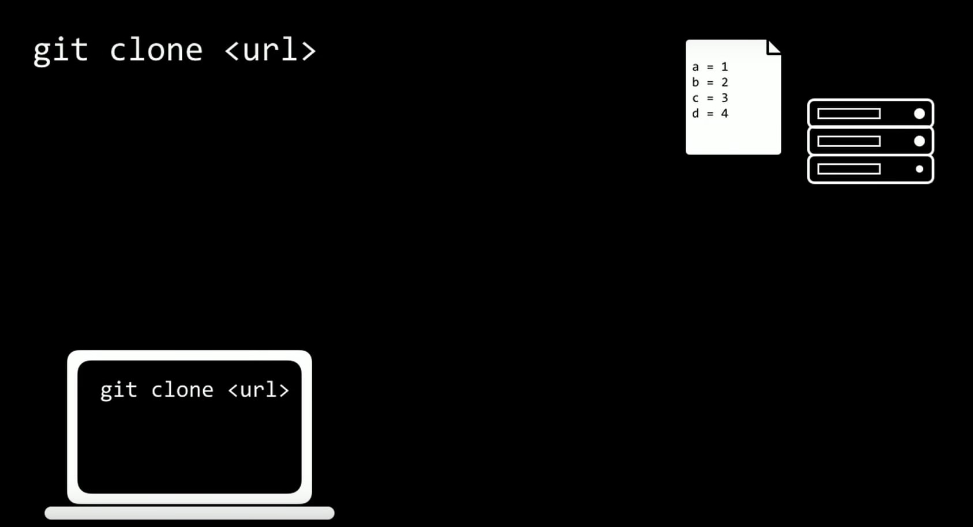

Slide 15
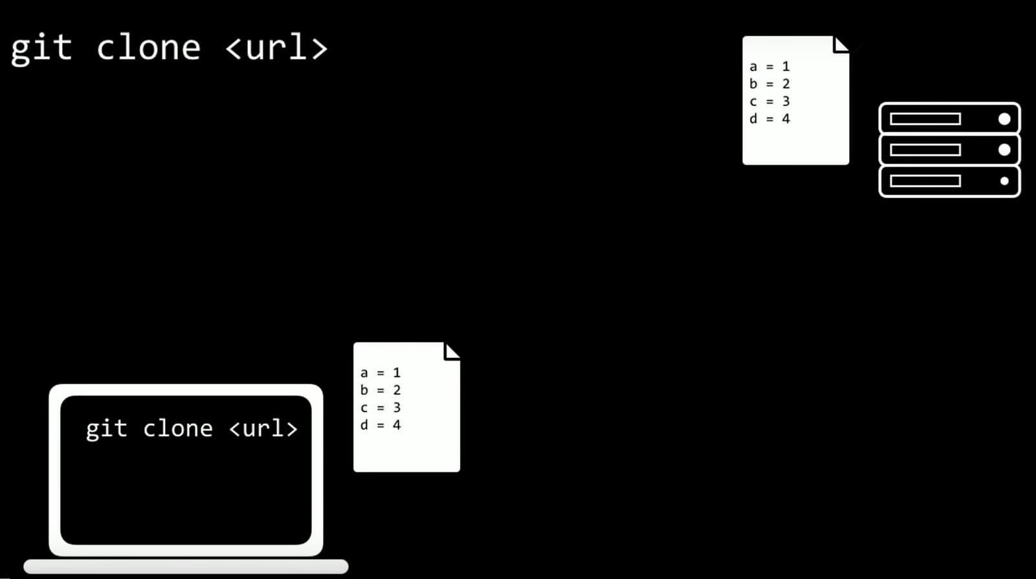

Slide 16
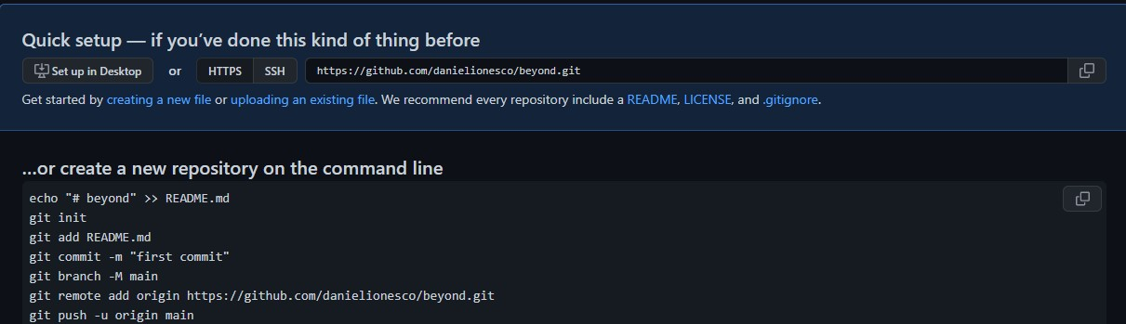
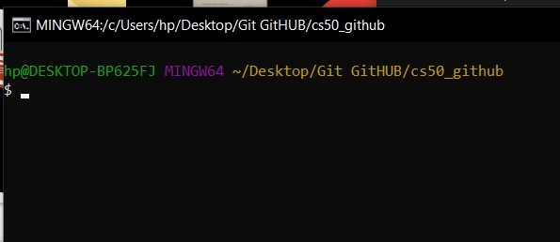
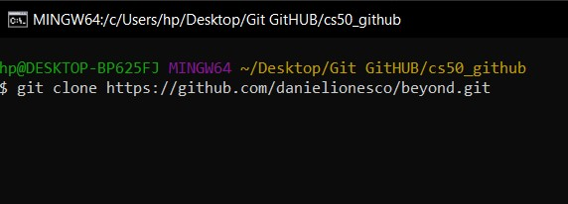

Slide 17
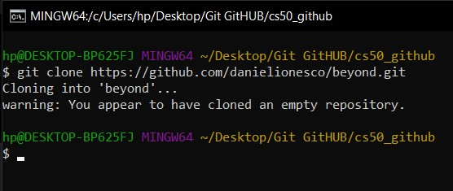

Slide 18
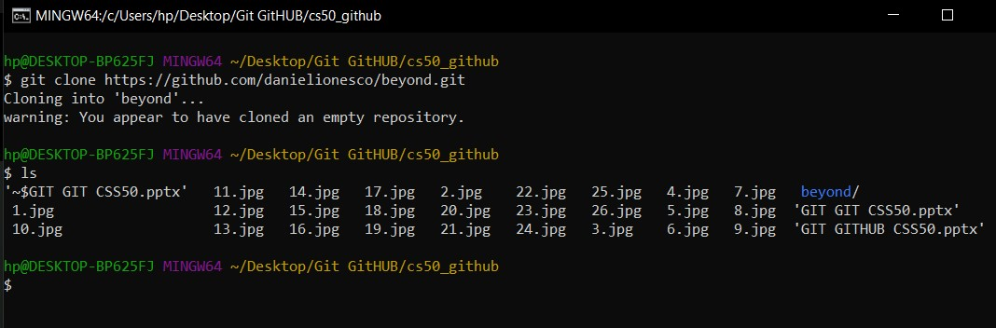

Slide 19
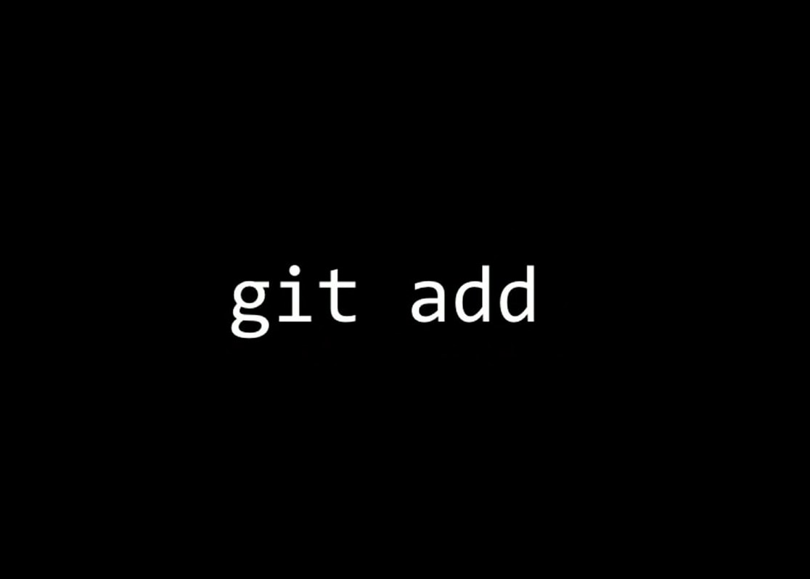

Slide 20
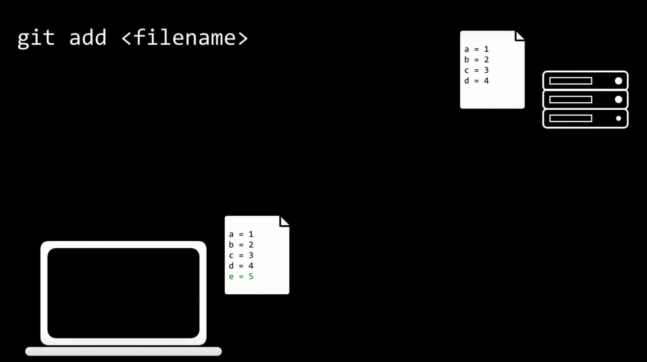

Slide 21
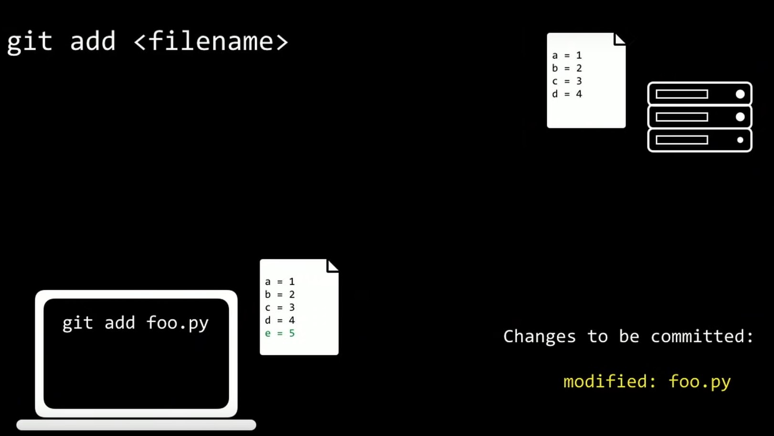

Slide 22
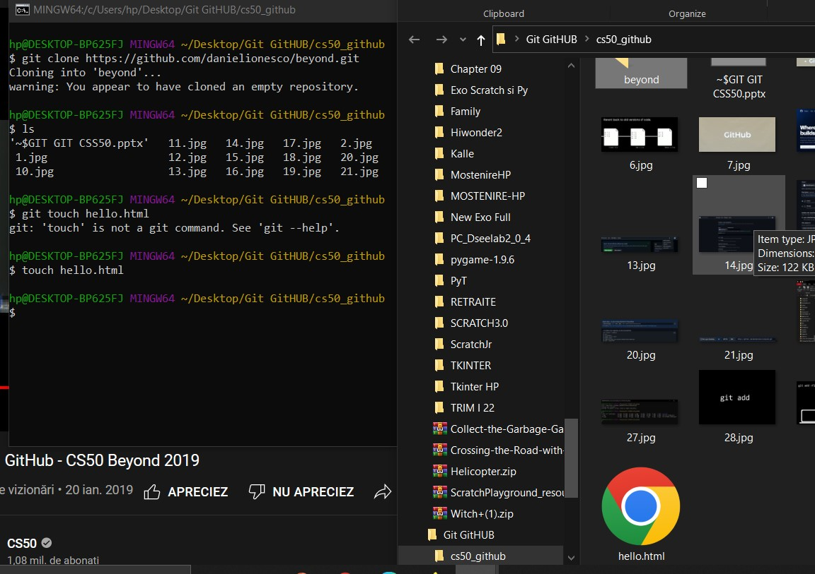

Slide 23
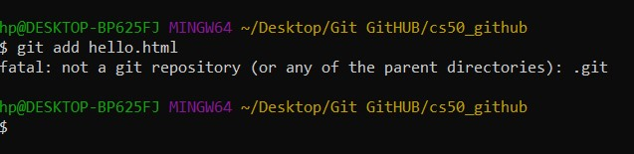

Slide 24
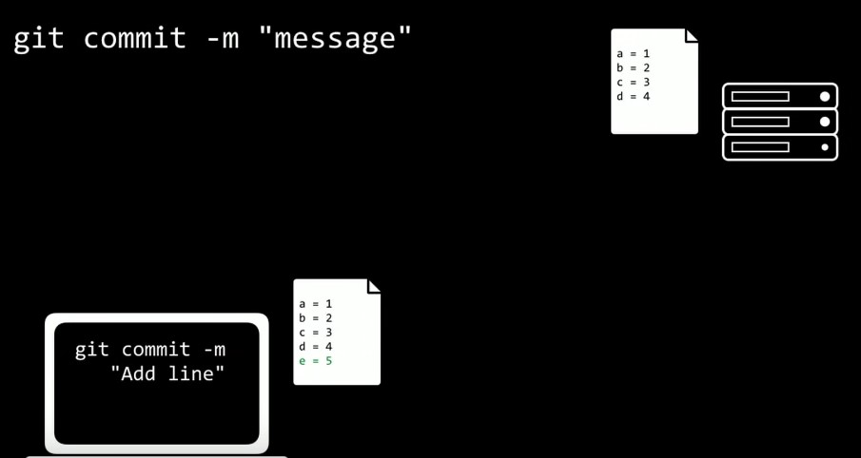

Slide 25
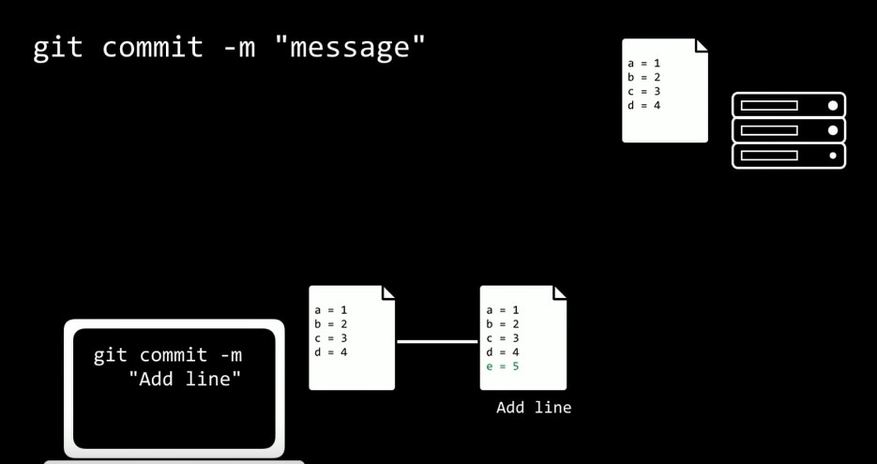

Slide 26
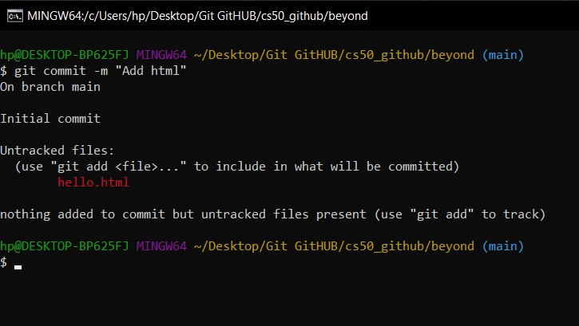

Slide 27
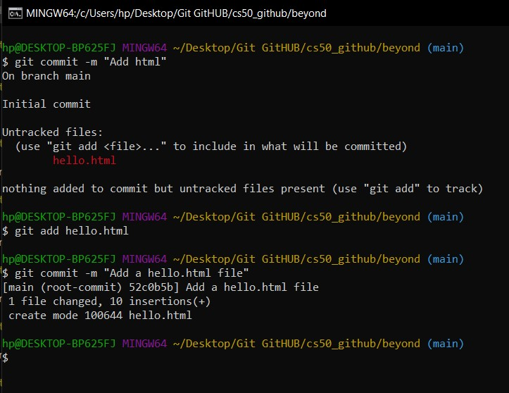

Slide 31
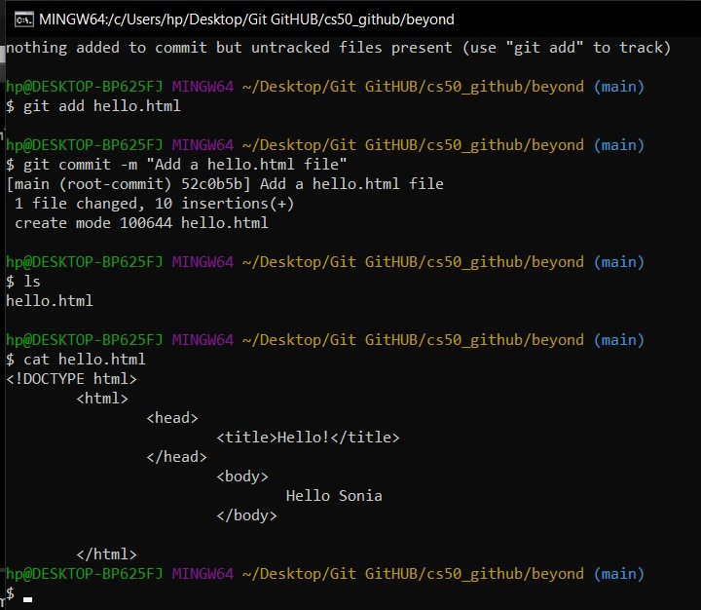

Slide 33
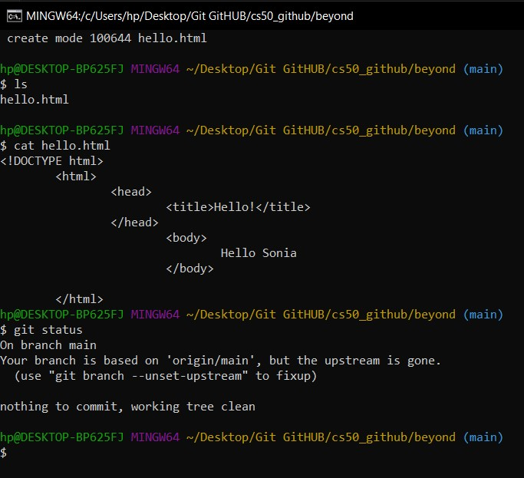

Slide 34
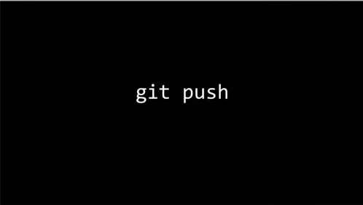

Slide 37
<!DOCTYPE html>
<html>
<head>
<meta charset="utf-8">
<meta name="viewport" content="width=device-width, initial-scale=1">
<title>Sonia Cute Cita</title>
<link rel="icon" type="image/x-icon" href="favicon.jpeg">
<link rel="stylesheet" type="text/css" href="style1.css">
</head>
<body>
<header>
<div class="top">
<ul class="nav-menu">
<li class="homebtn"> <a href="">Home</a></li>
<li> <a href+"">About</a></li>
<li> <a href+"">Why</a></li>
<li> <a href+"">Donate</a></li>
<li> <a href+"">Contact</a></li>
</ul>
</div>
<div class="tagline">
<h1>Putin wont nuke your house if you donate to Cita (a lot please)!</h1>
<div class="Donate">
<a href="" class="bttn">Donate </a>
*
{
margin: 0;
padding: 0;
}
header{
background-image: linear-gradient(rgba(0,0,0,0.5), rgba(0,0,0,0.5)),url("Cita70389.jpg");
height: 100vh;
background-size: cover;
background-position: center;
}
.nav-menu{
float: right;
list=style: none;
margin-top =30px;
}

Slide 38
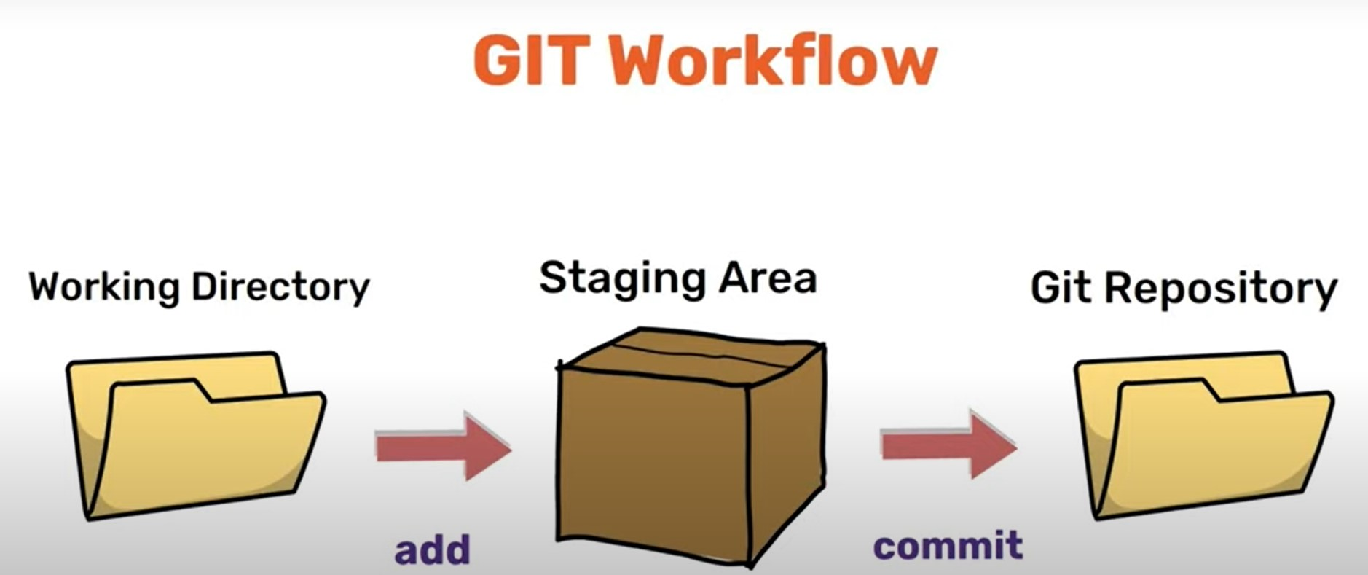
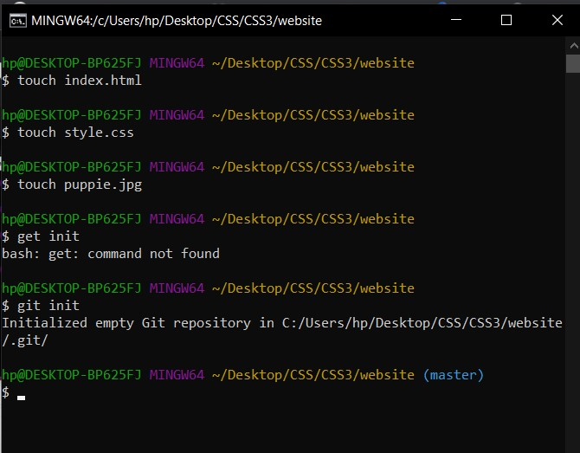
Git init creates a new subdirectory named .git that contains all of your necessary repository files — a Git repository skeleton.
At this point, nothing in your project is tracked yet.

Slide 39
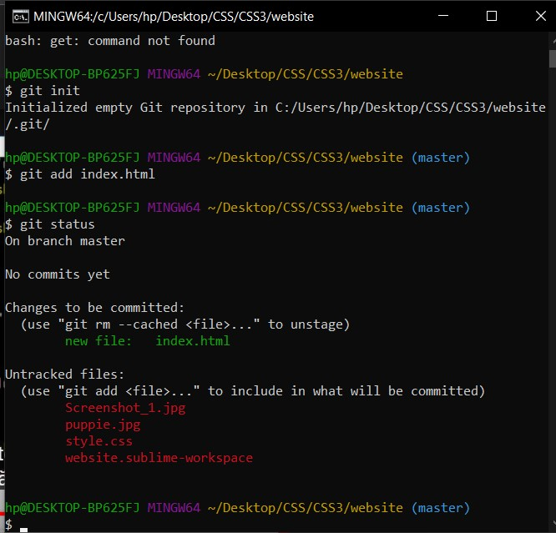
to start version-controlling existing files (as opposed to an empty directory), you should probably begin tracking those files and do an initial commit.
You can accomplish that with a few git add commands that specify the files you want to track, followed by a git commit

Slide 40
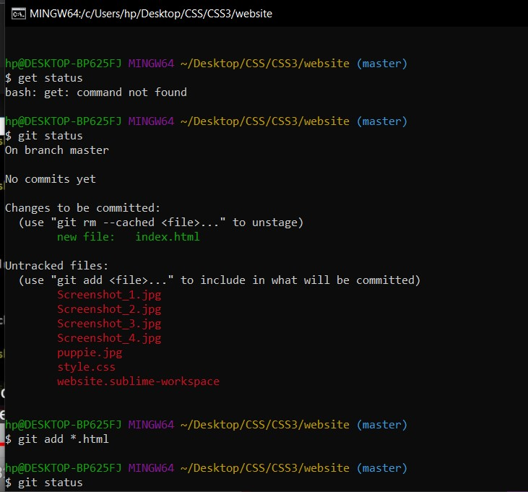
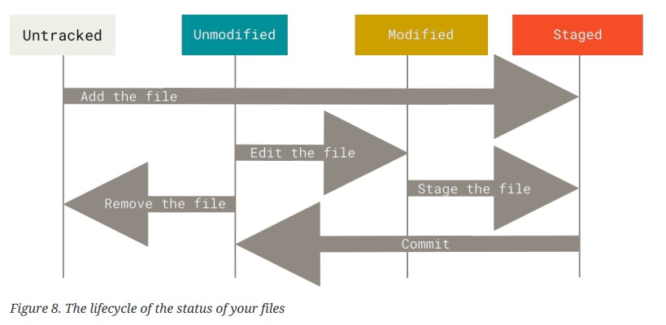
Recording Changes to the Repository

Slide 41
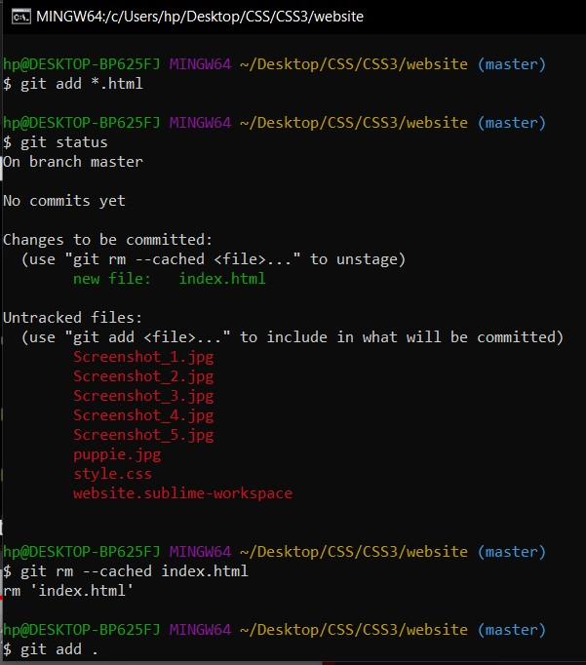

Slide 42
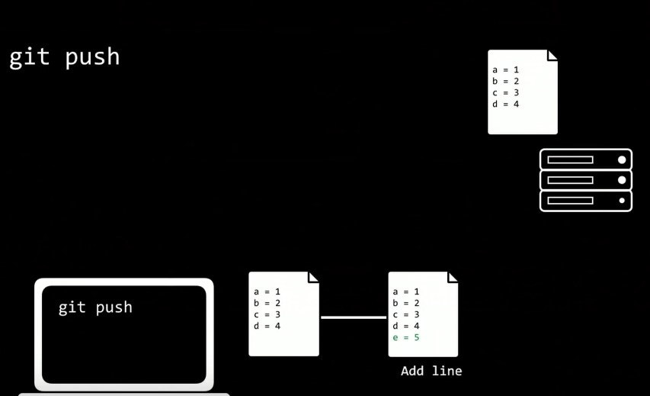
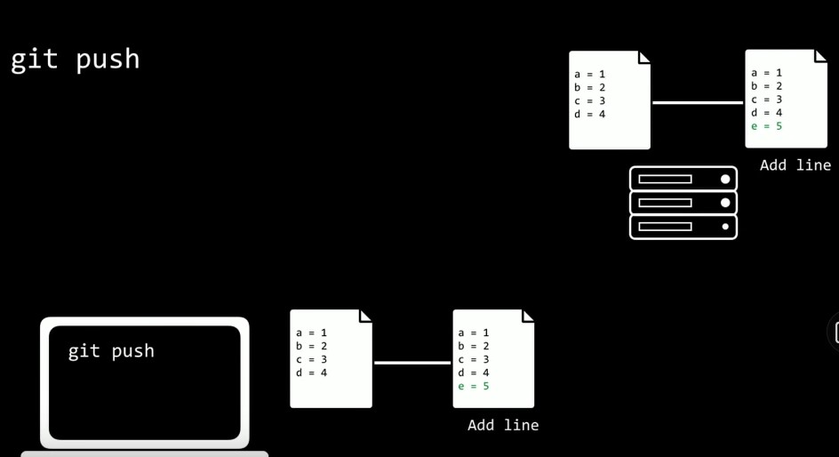

Slide 43
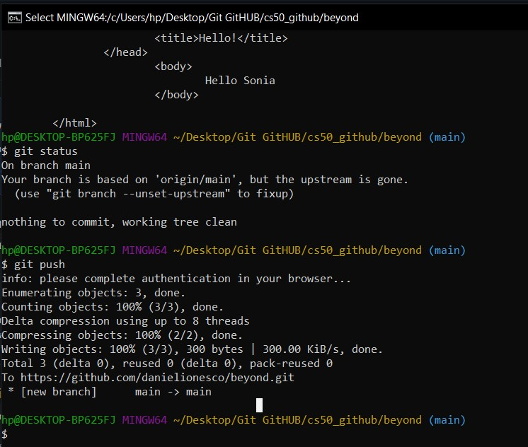

Slide 44
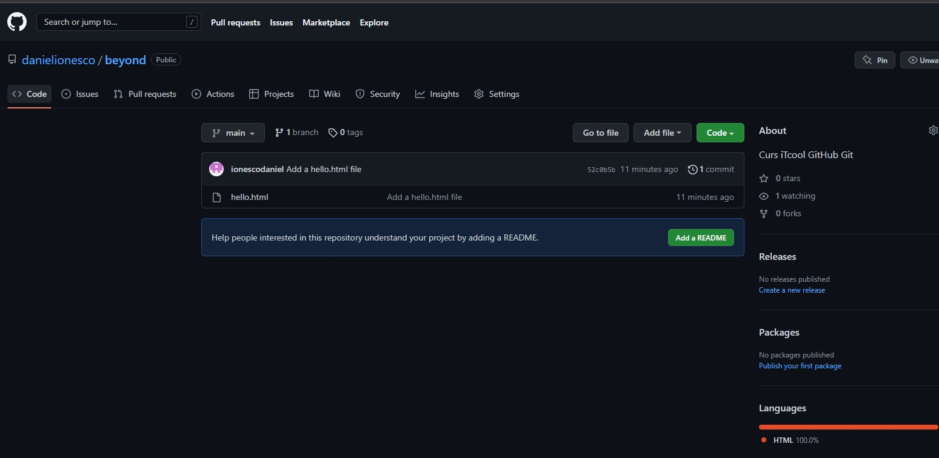

Slide 45
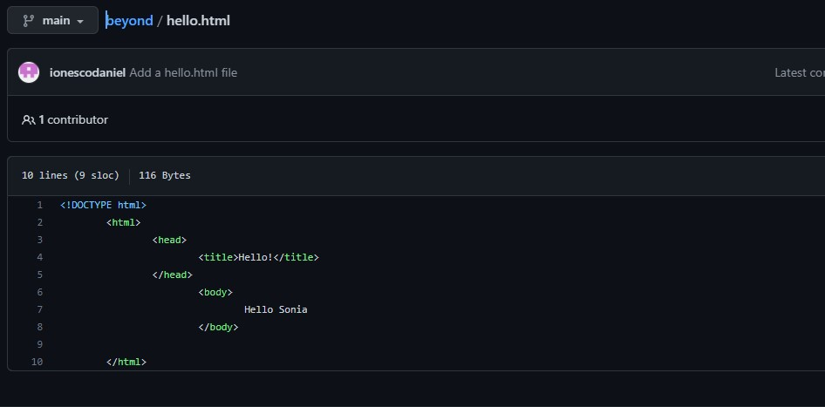

Slide 47
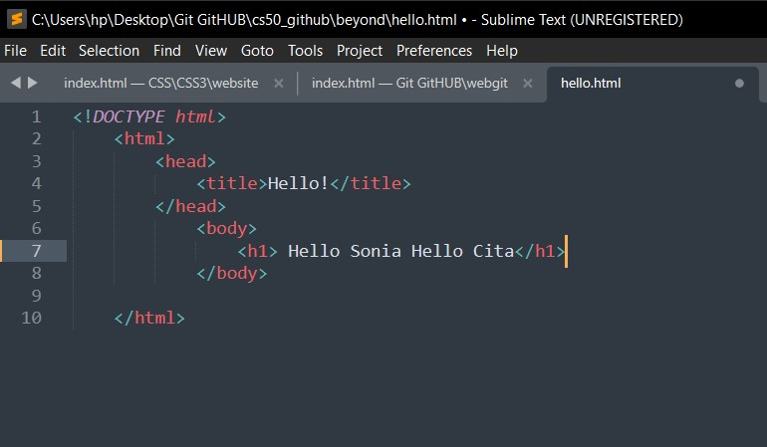

Slide 48
